Slide 1
POVs AND EXPERIENCE PROTOTYPES
Michael Freeman
Andrea Rodriguez
Alan Khaledi

Slide 2
PROBLEM DOMAIN
LIVE MUSIC/MUSICIAN DISCOVERY
Notes:
Our problem domain is music and/or musician discovery. From our field research, we discovered that there are few avenues for up-and-coming musicians to share their talent with other musicians, and moreover for music enthusiasts to discover existing live shows that are in their area.

Slide 3
INITIAL POV
We met Griffin S. who wants to find other musical artists to collaborate with. It would be game changing if he could easily meet others who would be willing to work with him.
Notes:
We spoke with Griffin Stoller, a student producer and violinist. He expressed a desire to make connecting with other musical artists in the area more convenient. He felt that there would be a large space in the market for a platform to help artists get in touch with one another for collaborations. He stressed how much he enjoys connecting with other musicians and how much of a struggle it can be to initiate this connection. It would be great to find a solution could be designed to facilitate collaborations between musical artists.

Slide 4
ADDITIONAL NEEDFINDINGS
UCHE U.
actor/singer/ Model in LA
strong interest in making connections
experienced difficulties as an up-and-coming artist
KEVIN M.
CS at Berkeley
little music experience
felt emotional at Bryan Adams concert
has trouble finding local events
MELINA R.
TV producer in LA
highly interested in music
career in media didn’t connect her to her interest in music
Notes:
We met Uche Uba, is an actor/singer/model living in Los Angeles, CA. As an upcoming singer in the music industry, Uche communicated a strong interest in connecting with others in the field to collaborate with. He expressed how difficult it is for up-and-coming musical artists to connect with others artists.
We talked with Kevin Munui, a student at Computer Science U.C. Berkeley with little musical experience but a special place in his heart for it. He spoke about the Bryan Adams concert he attended in 6th grade, where he felt the strongest emotional connection to music he’s ever felt. He expressed how he wants to have more concert experiences like this but has trouble finding good local concerts to attend.
We also met, Melina, a TV producer based in Los Angeles, CA. Melina’s life isn’t focused on music, yet she retains it as a special significance in her life. Despite being in media and being involved in industry, her career in music never really took off, even though others could likely benefit from her production/musical knowledge.

Slide 5
REVISED POVs
POV 1
We met Uche U. who wants to find local musical artists to connect with. It would be game changing to be able to connect with like-minded musicians.
POV 2
We met Kevin M. who wants to see great live shows, but has difficulty finding them. It would be game changing if he could streamline this process.
POV 3
We met Melina R. who needs a way to connect with others in media. It would be game changing if she could expand her media experience to include the music industry.
Notes:
POV: We want to help Uche connect with like-minded musicians.
POV: We want to streamline the process of finding great live music so that Kevin can find more live shows in his area and, in doing so, discover new artists.
POV: We want to help Melina connect with others in the music industry to expand her experience within multi-media industries

Slide 6
TOP HMWs

Slide 7
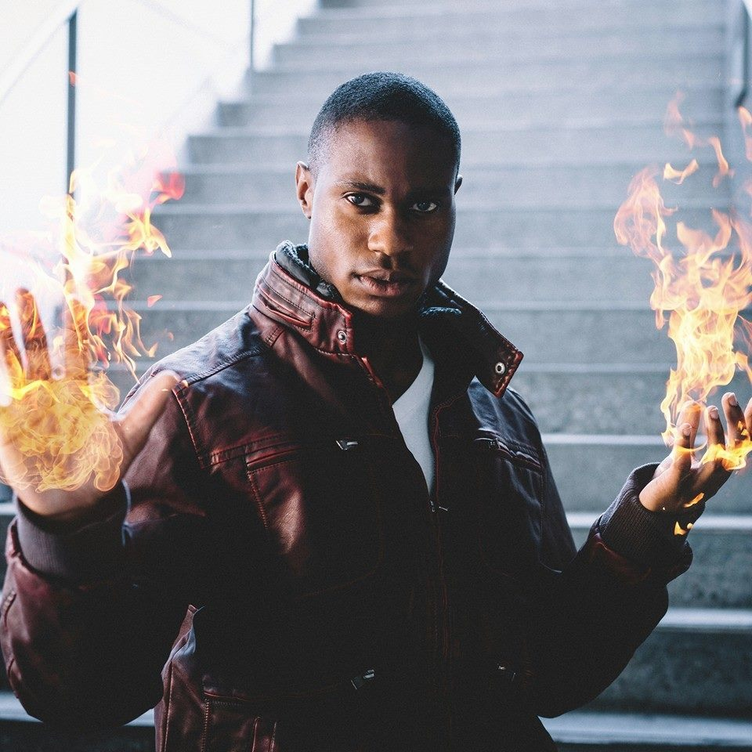
1. “How might we help musicians meet other musicians in the area?”
POV: Uche U.

Slide 8
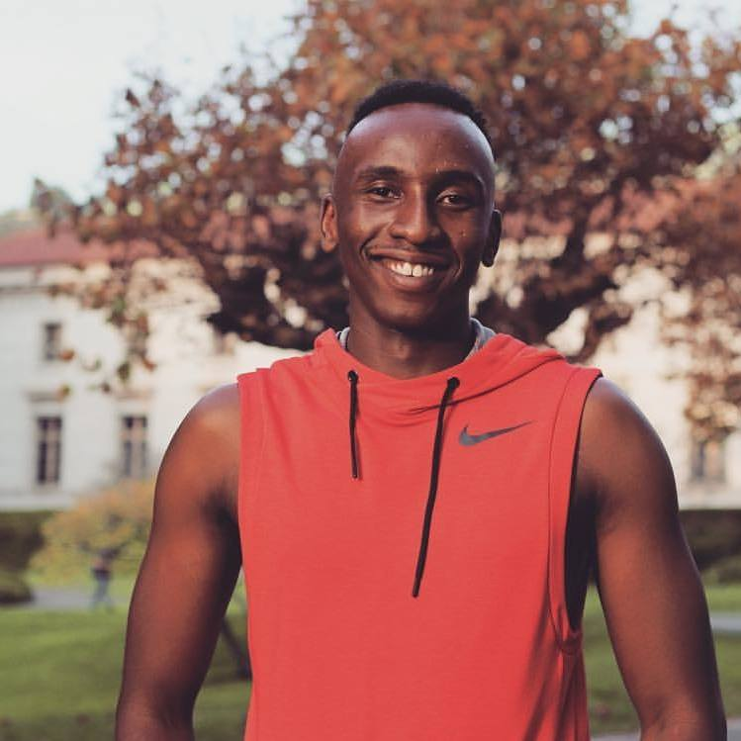
2. “How might we reduce the time commitment needed to stay updated and find new artists/live performances that someone will love?”
POV: Kevin M.

Slide 9

3. “How might we help experienced people make a career out of their interests in music?”
POV: Melina R.

Slide 10
EXPERIENCE PROTOTYPES

Slide 11
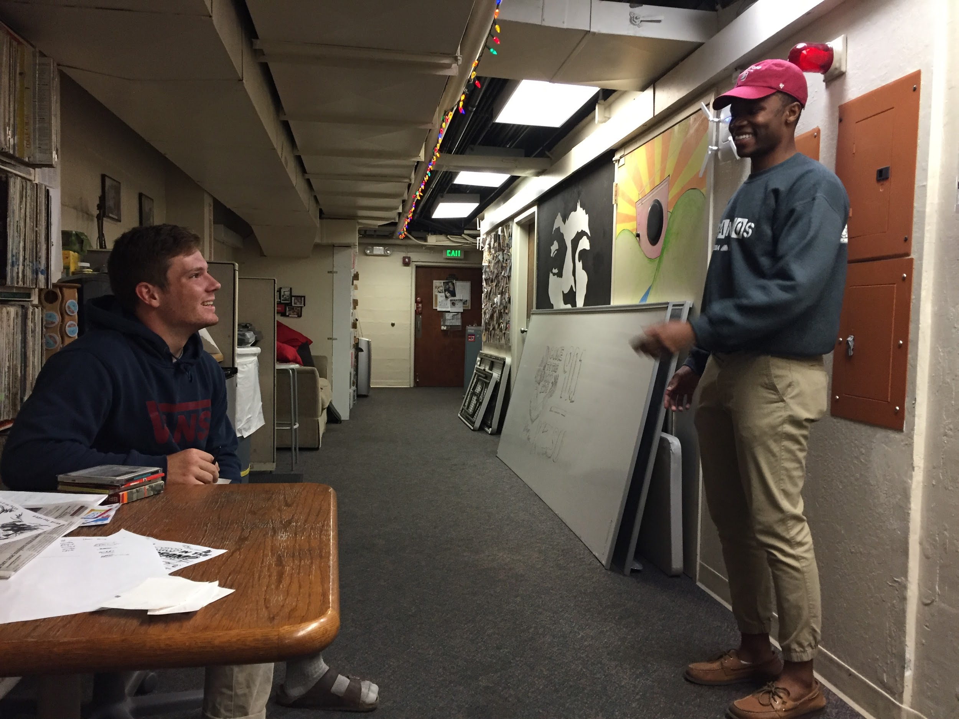
PROTOTYPE 1: MEET MUSICIANS
“HMW help musicians meet other musicians in the area?”
Notes:
For this experience prototype, we tackled the problem of connecting different artists to collaborate with one another. Our idea uses a Tinder-esque rating system that matches users who both indicate an interest in collaborating with one another. Users may swipe right on other users to indicate an interest in collaborating after viewing a short 20-30 second video of another user demonstrating their musical talent. A 20-30 second limit keeps this idea in tune with other social media platforms and prompts for a greater degree of creativity from users since every second counts.

Slide 12
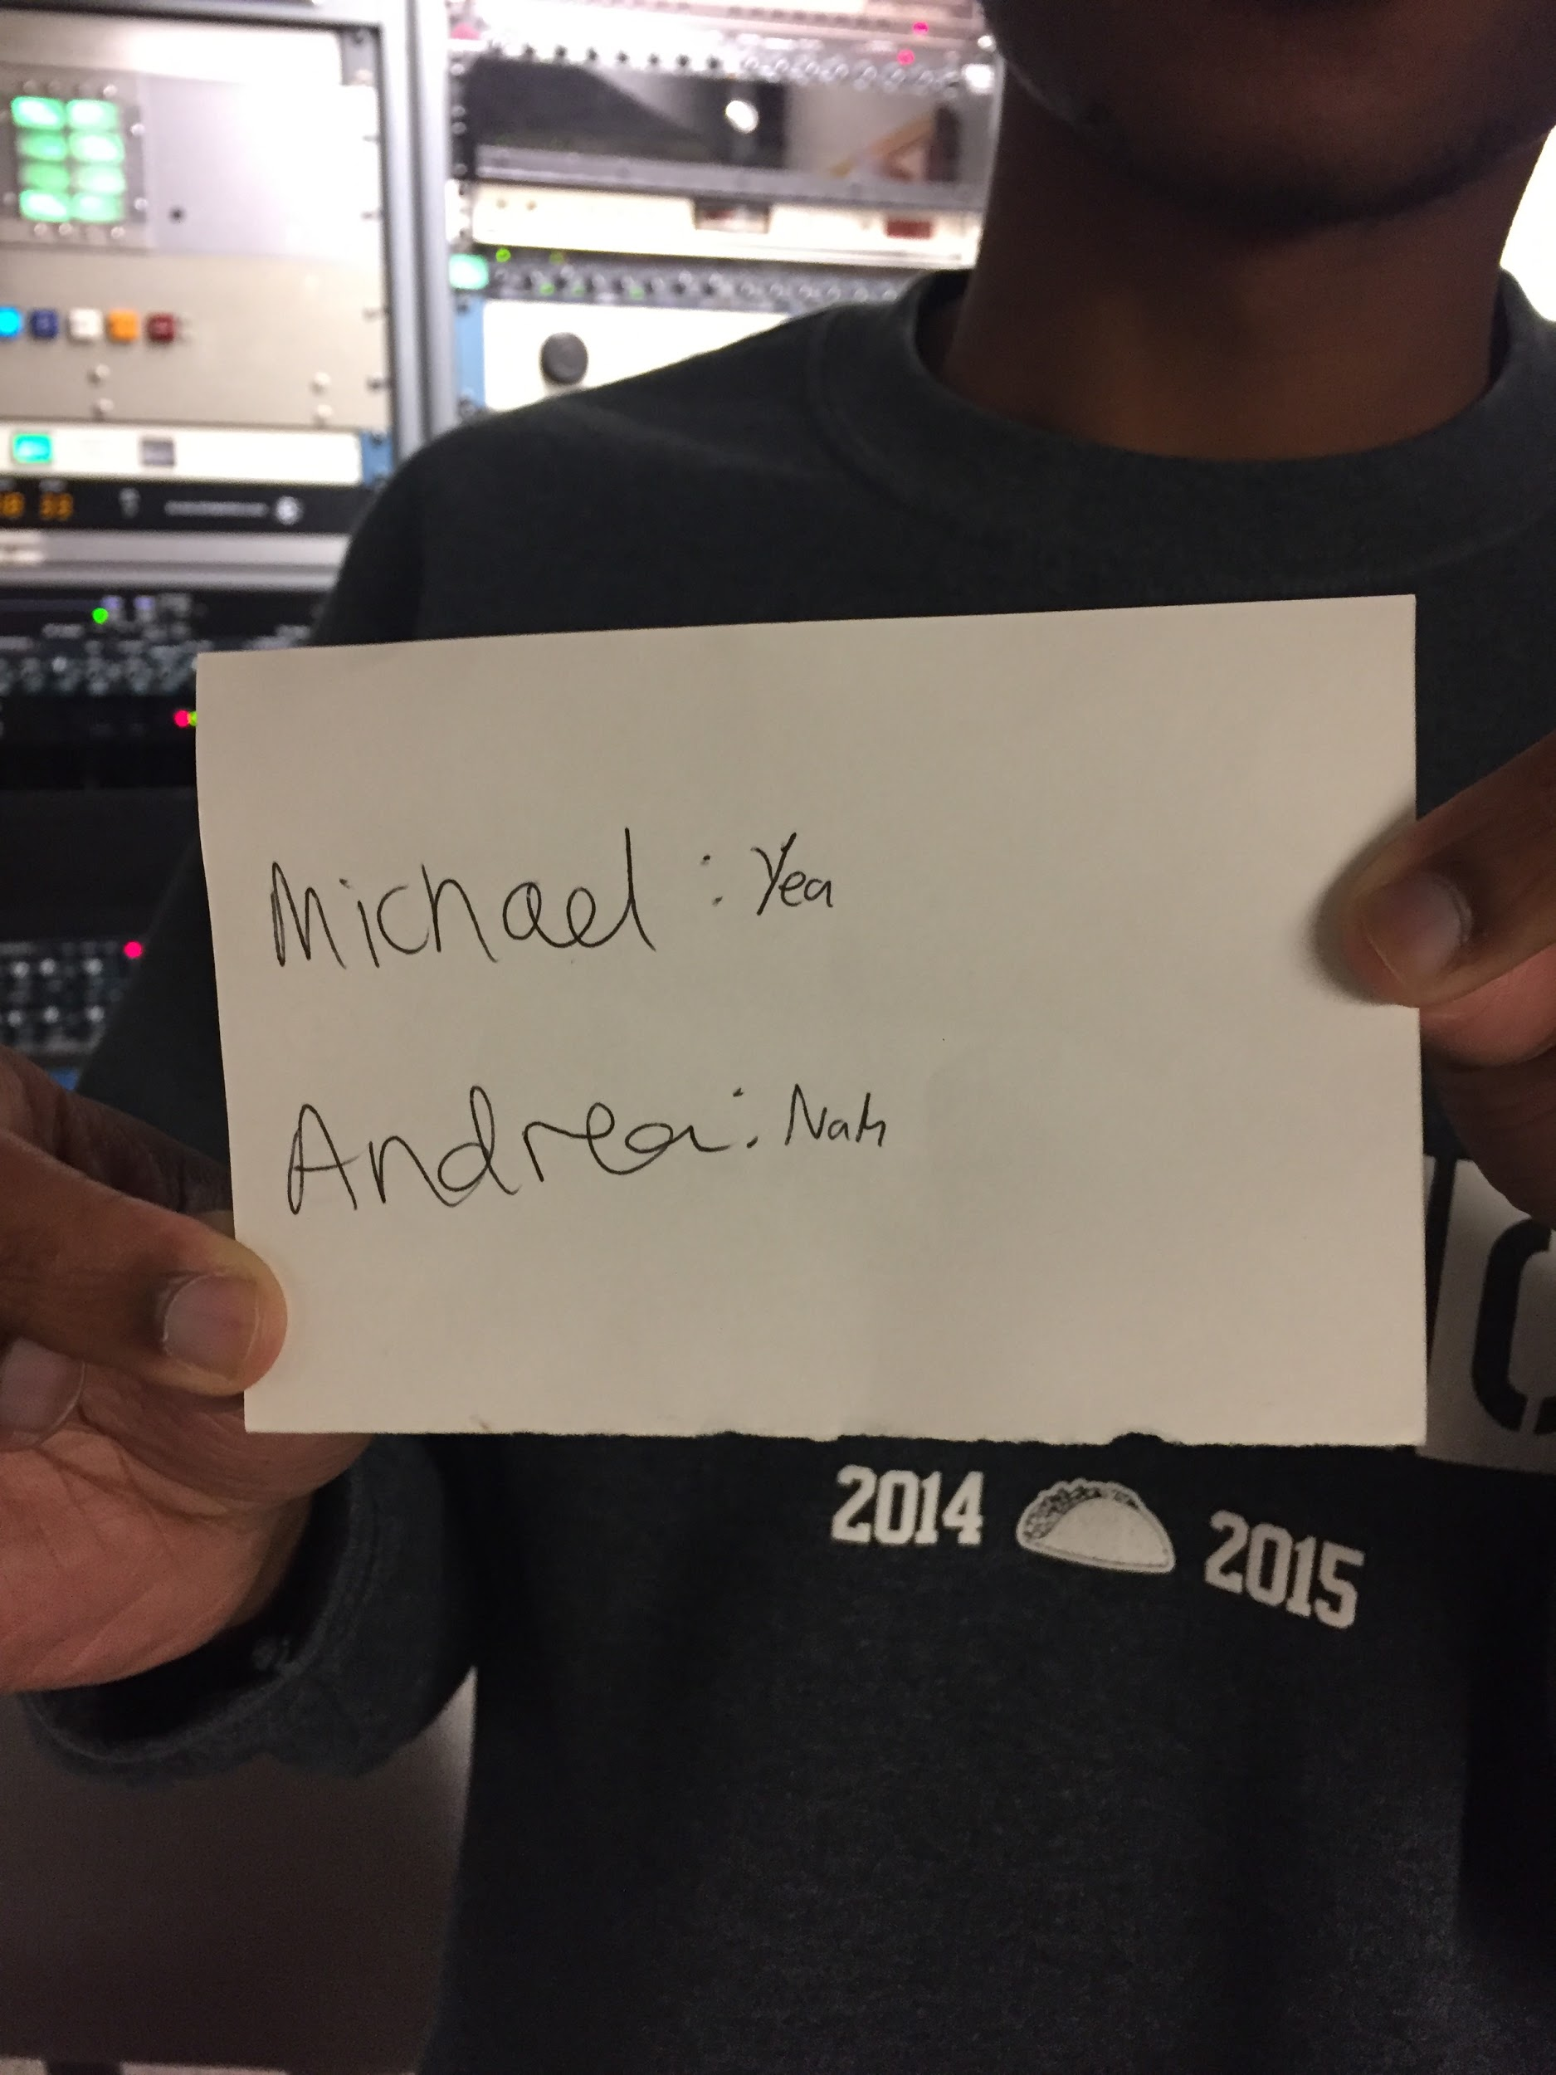
HOW WE TESTED IT
Short 20-30 second performance
Test subject has a card
Each person participating indicates yes or no secretly
Matches are revealed
Notes:
We each put on a small 20-30 second performance for a test subject at the Stanford radio station (with an interest in music) named Jack. For most of us this involved light singing, with a little dancing. Jack was provided a card with our names written on it, and asked to indicate on this card whether or not he would be interested in collaborating with us musically after seeing this brief snippet of our “talent”. We then got together in a separate room and made judgments as to whether we would be interested in collaborating with him. To keep him from having to put himself in an uncomfortable position by making him perform for us to judge, we randomized which ones of us were going to say “yes” to collaborating with him. We then asked him to reveal which people he answered yes to, and the end result was that he was matched for a collaboration with Michael! (Both responded yes to an interest in collaborating).

Slide 13
ASSUMPTIONS
Answers would remain the same whether or not we were online or offline
We could simulate a performance that is just as effective with our without editing
20-30 second limit prompts for a greater degree of creativity from users since every second counts

Slide 14
WHAT WORKED?
Rating system resulted in a successful match
Jack really enjoyed and supported this idea
WHAT DIDN’T?
Simulation had multiple limitations (as discussed on the next slide)

Slide 15
WERE OUR ASSUMPTIONS VALID?
Answers would probably not be the same online vs offline
Users would be more critical of our performances if they did not have to see us in person
There was a limit to how impressive our offline performance could be

Slide 16
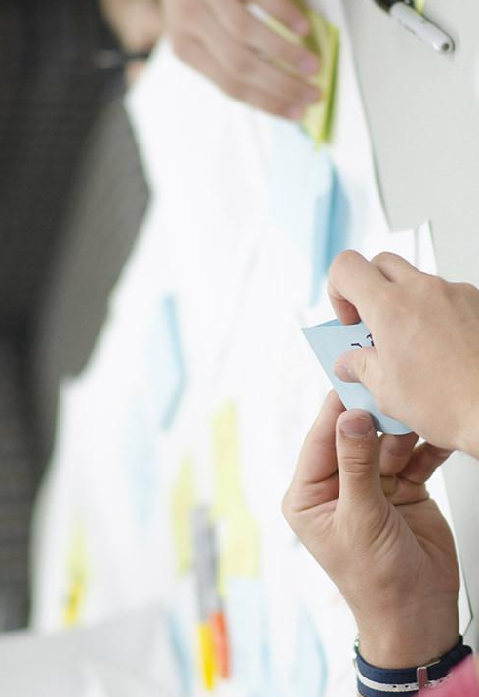
PROTOTYPE 2: FIND LOCAL CONCERTS
“How might we reduce the time commitment needed to stay updated and find new artists/live performances that someone will love?”

Slide 17
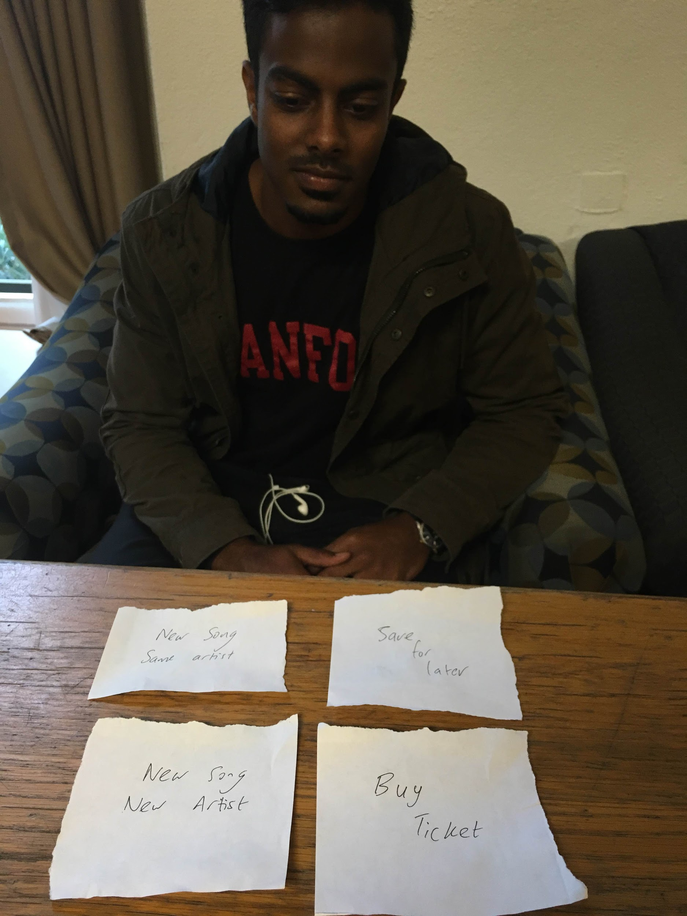
HOW WE TESTED IT
Part 1: Told user to find concert in a given location and try to simulate the process of buying tickets
Part 2: Gave user 4 cards, user chooses option, we simulate that option
Notes:
we did two iterations of this experiment. In the first, we asked the participant to keep looking until they find a concert they’re happy with. The participant ended up spending 11 minutes and 14 seconds to check out three artists, listen to 1 song from each and choose to buy the ticket for one. Their process included searching for concerts on a website such as songkick, and then switching to youtube or spotify to listen to the artists of their prospective concert choices. After which, they would continue to try to buy it from a range of ticket resellers online, all of which require you to sign up -- adding to the required time.
In the second part, the user had four cards given to him which served as the only source of communication with me (we served as the app, simulating the actions that will be built in the final prototype.

Slide 18
ASSUMPTIONS
People’s level of interest and likeliness to continue with the task at hand would be the same in both tasks
The time it took us to perform the user’s actions/cards would be as fast as the envisioned app

Slide 19
WHAT WORKED?
We managed to find a concert the user prefered more
Our process was faster than theirs
WHAT DIDN’T?
Users preferred to have more control over their choices

Slide 20
WERE OUR ASSUMPTIONS VALID?
People’s level of interest and likeliness to continue the first task is usually low
Time it took us to perform the user’s actions/cards would probably be slower than the envisioned app

Slide 21
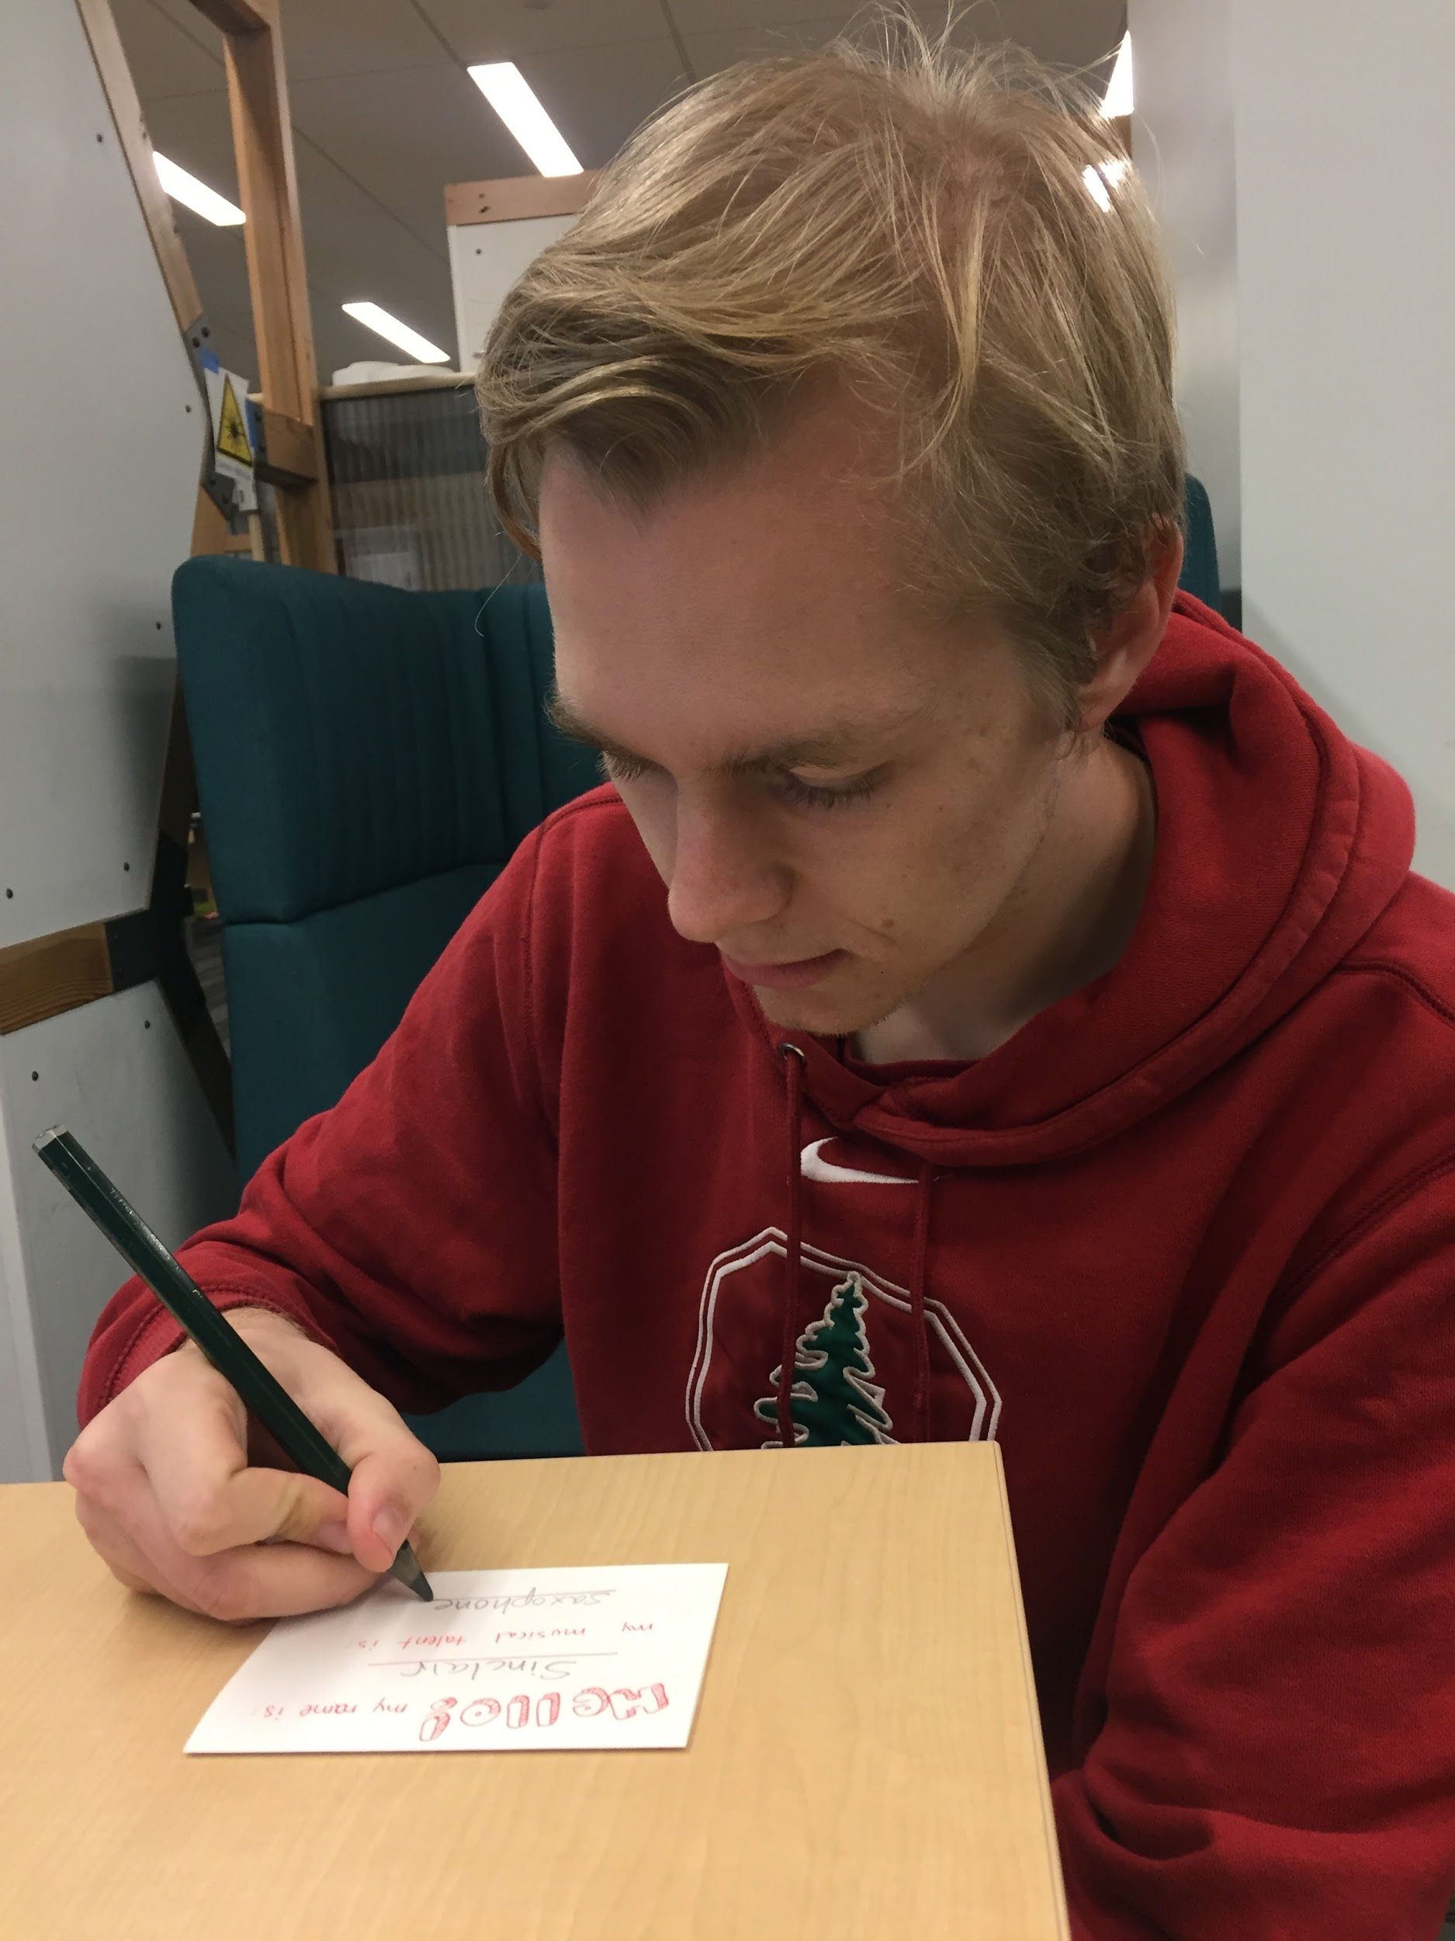
PROTOTYPE 3: MEET
INDUSTRY PROS
“HMW help people make a career out of their interests in music?”
Notes:
We made cards that simulated how the user interface would work.

Slide 22
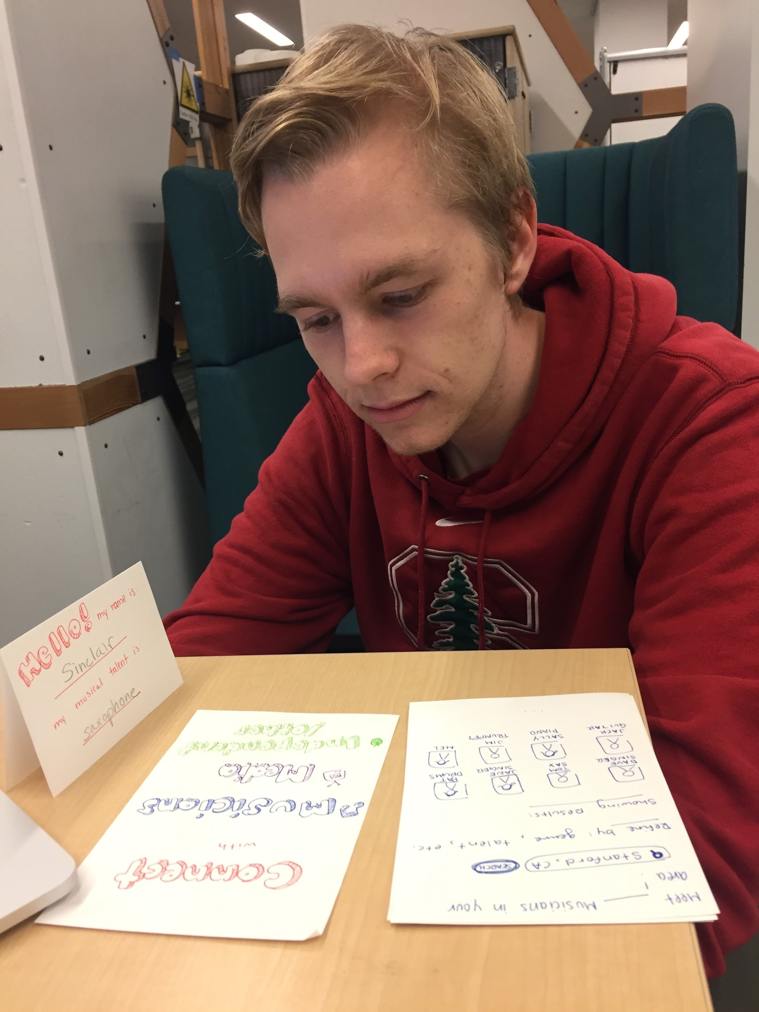
HOW WE TESTED IT
Gave a musician a card to “sign up”
Had him look at the first card with options
Had him explore the other pages
Notes:
In this experience prototype, we considered how various media industry professionals could find other professionals and opportunities in music. The prototype attempts to mirror an online network where musicians, industry professionals, and venues can network with one another wherever there is a listing. Say a band is touring, but their drummer falls ill--how can they quickly find another replacement in their current city? Or alternatively, say we have someone like Melina with experience in television and video production--how can someone looking to hire a motivated producer locate someone like her? The possibilities for matching are endless, as these sorts of needs always arise, but it’s not always easy to find a match.

Slide 23
ASSUMPTIONS
The offline version can be as interactive as the online version
This could bring opportunities and connections that musicians and industry people don’t already have
Users will understand how the layout works
Notes:
In this experience prototype, we considered how various media industry professionals could find other professionals and opportunities in music. The prototype attempts to mirror an online network where musicians, industry professionals, and venues can network with one another wherever there is a listing. Say a band is touring, but their drummer falls ill--how can they quickly find another replacement in their current city? Or alternatively, say we have someone like Melina with experience in television and video production--how can someone looking to hire a motivated producer locate someone like her? The possibilities for matching are endless, as these sorts of needs always arise, but it’s not always easy to find a match.

Slide 24
WHAT WORKED?
Option to refine search
The music page showing other local musicians was understandable
WHAT DIDN’T?
Categories seemed unclear
Participants didn’t realize it was music-specific

Slide 25
WERE OUR ASSUMPTIONS VALID?
The offline version had issues with making the users find the right pages
Professional musicians might already have connections--is this for amateurs only?
The interface wasn’t as understandable as we thought

Slide 26
WHICH PROTOTYPE DID WE FIND MOST SUCCESSFUL?

Slide 27
PROTOTYPE 1: MEET MUSICIANS
Prototype 2: Less needfinding support
Prototype 3: importance of intuitive UI design
Notes:
We found that our prototype 1, which aimed at finding potential collaborators, was the most successful in achieving a desired solution. We wanted our users to be entertained by the brevity and creativity of a short performance, then hopefully be able to find a match with someone they would collaborate with. Although its drawbacks were that each offline performance could not match the
potential of a recorded performance with editing and extra takes, we found that it
was still possible for users to show their talent and make a good impression. Our participant Jack in the end was pretty enthusiastic about the idea and enjoyed taking
part in the experiment. The set up overall made sense to people and also appealed to a number of concerns raised in our need finding process. In contrast, prototype 3 had some significant issues with design and prototype 2 had less support from our need finding interviews.

Slide 28
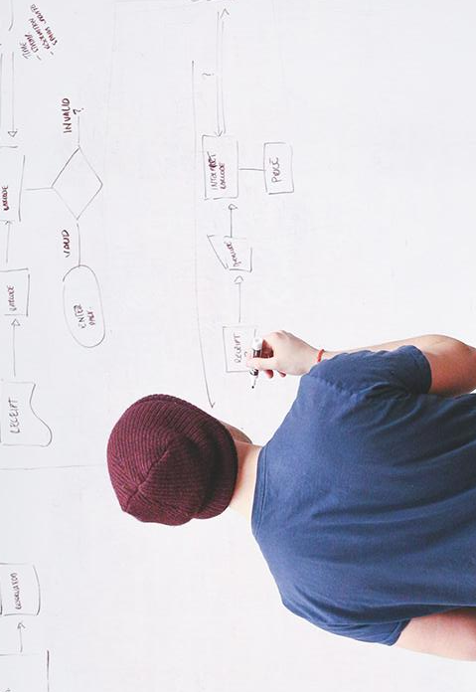
THANKS!

